Slide 1
CET311
Project Management
On Arrow Solutions
Dr R L Warrender

Slide 2
Exercise 1: On Arrow
2
5
d = 4
10
10
6
6
0
0
a = 6
h = 2
e = 3
1
3
8
0
0
b = 4
6
12
12
4
7
0
6
9
0
3
f = 2
3
c = 3
i = 1
j = 2
7
4
7
10
3
7
3
4
g = 3

Slide 3
Exercise 2: On Arrow
2
3
3
c = 7
a = 3
0
h = 4
4
1
0
0
10
10
0
e = 6
0
d = 5
5
i = 3
6
b = 5
3
16
16
19
19
5
5
f = 4
0
0
0
g = 8

Slide 4
Exercise 3: On Arrow
4
d = 3
5
5
2
2
2
0
h = 4
0
i = 8
a = 2
e = 5
1
6
7
2
0
0
b = 4
j = 2
13
13
15
15
0
0
0
c = 3
f = 6
l = 3
3
3
7
g = 4
5
7
12
4
5
k = 4

Slide 5
Exercise 4: On Arrow
3
8
8
e = 3
b = 5
0
1
2
5
6
7
8
a = 3
f = 4
h = 3
i = 1
0
0
3
3
8
8
12
12
15
15
16
16
0
0
c = 3
d = 1
0
0
0
0
4
6
7
g = 2
1

Slide 6
Exercise 5: On Arrow
2
c = 14
a = 3
3
4
1
d = 5
1
5
0
0
4
g = 8
h = 5
6
0
9
9
17
17
22
22
b = 5
0
0
0
3
e = 4
f = 7
5
5
0

Slide 7
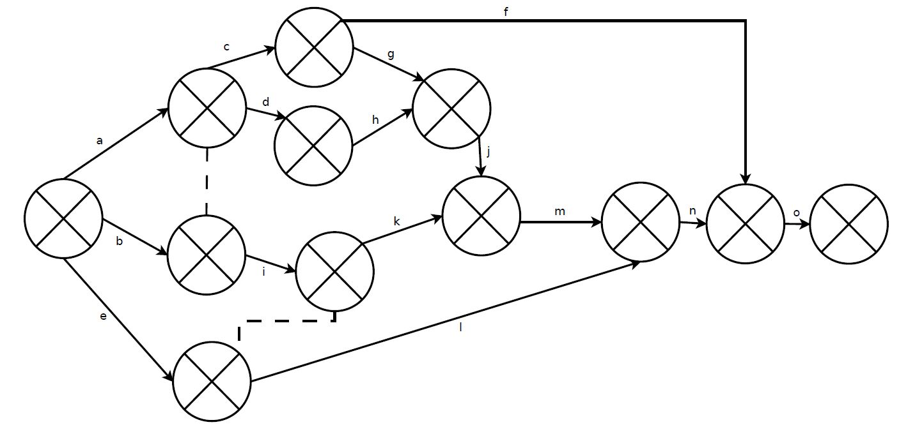
Exercise 6: On Arrow

Slide 8
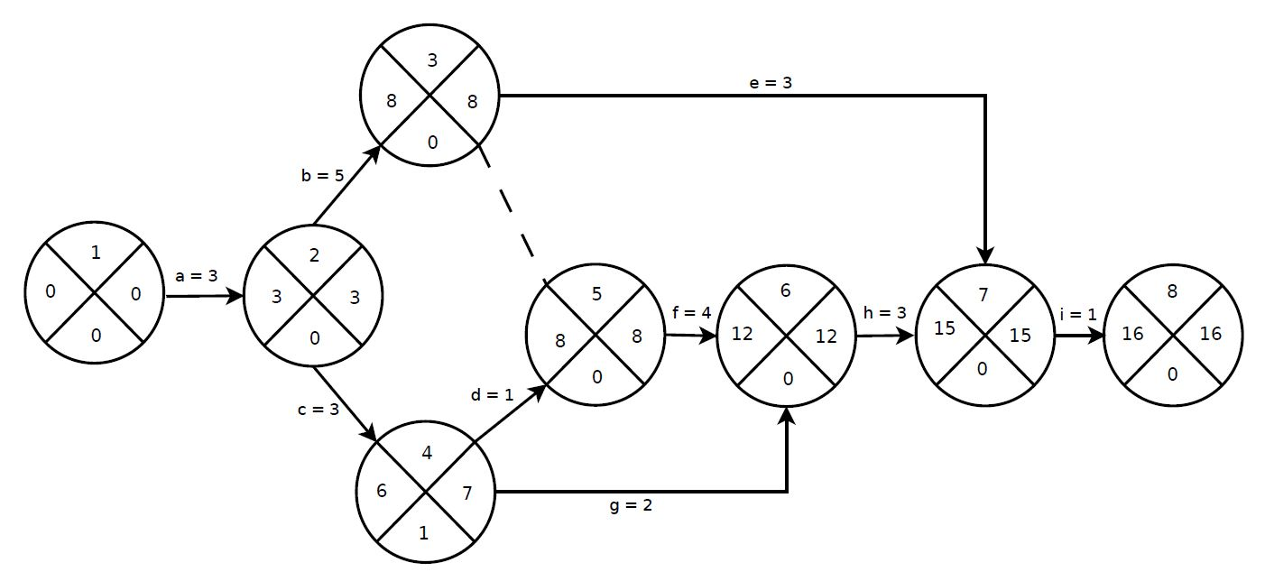
Exercise 7: On Arrow

Slide 9
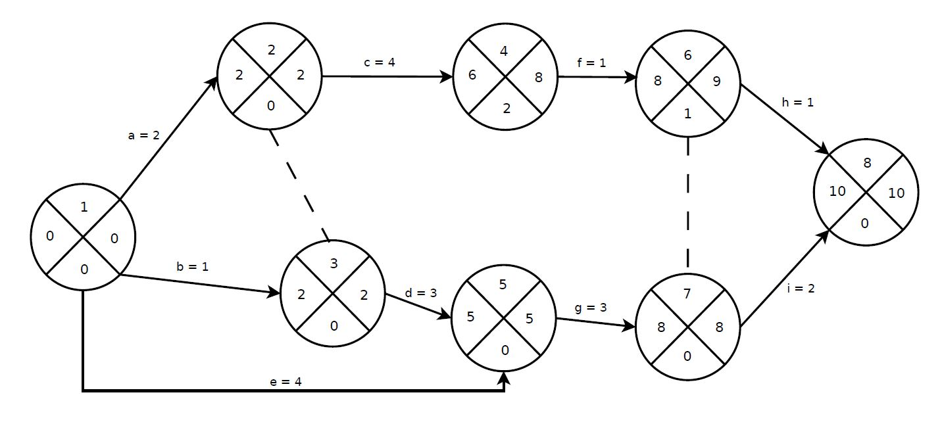
Exercise 8: On Arrow

Slide 10
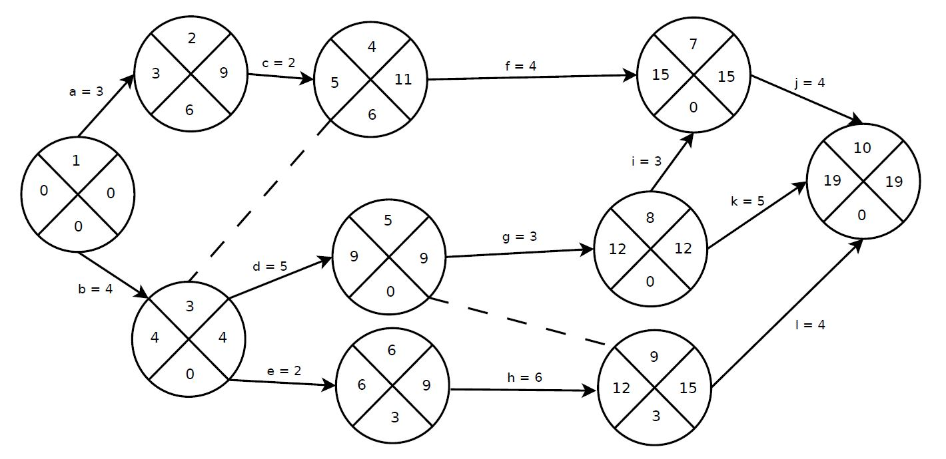
Exercise 9: On Arrow

Slide 11
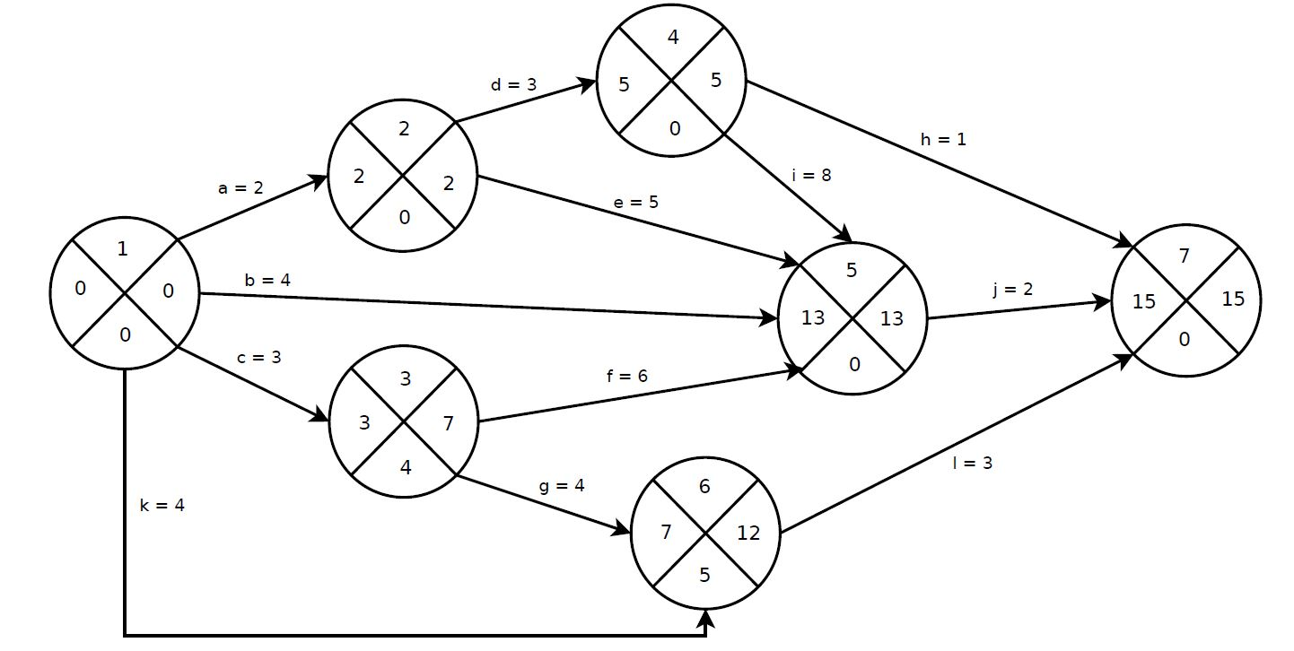
Exercise 10: On Arrow

